Slide 1

Django Templates & Forms
Template system, template tags, Handling forms, model forms
Program: EDGE-CSE CUET DIGITAL SKILLS TRAINING
Course: Python (Django) [Intermediate]
Lecture: Training Session-09 Date: 11th October, 2024 Duration: (2+2) hours
Instructor: Tanveer Rahman, Sr. Software Engineer, Friends Corp. Chuo-ku, Tokyo, JP shakil10vr@hotmail.com, 01626735005

Slide 2
Django Templates
Django’s template system separates presentation from business logic.
Allows dynamic HTML generation using template language.
Templates are typically stored in the templates directory within your app.

Slide 3
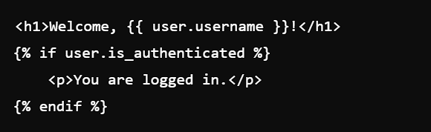
Template Syntax and Tags
Template language uses curly braces {} and percent signs %.
Example:
Variable Syntax: {{ variable_name }}
Template Tags: {% tag_name %} for logic (loops, conditionals, etc.)

Slide 4
Common Template Tags
Control Structures:
Template Inheritance:
Filters:
{% if %}, {% for %}, {% block %}
{% extends %}, {% block %}, {% include %}
Modify output of variables, e.g., {{ name|upper }}

Slide 5
Task 1: Using Template Tags and Filters (30 Mins)
Create a template that displays a list of items from Book, conditionally rendering messages if the list is empty.
Use filters to format dates or text.

Slide 6
Django FORMs
Forms in Django simplify data collection and validation.
Support for regular HTML forms and Model Forms.
Built-in validation and form handling logic.

Slide 7
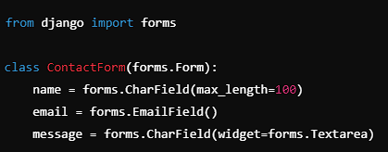
Creating and Handling Forms
Define a form using Django's forms.Form or forms.ModelForm.
Example:
Handle the form in the view, e.g., form.is_valid().

Slide 8
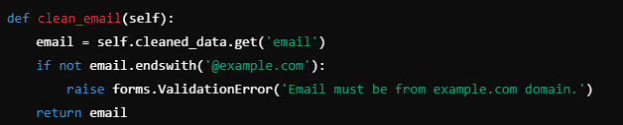
Form Validation
Forms automatically validate data when submitted.
Example:
Custom validation can be added using clean_fieldname methods or clean.

Slide 9
Template and Form Integration
Display forms in templates using {% csrf_token %} for security.
Use {{ form.as_p }}, {{ form.as_table }}, or {{ form.as_ul }} for layout.
Handle form submissions and redirect upon success.

Slide 10
Task 2: Create a Custom Form (30 Mins)
Create a contact form with fields for name, email, and message.
Add validation to check that the email domain is "example.com".

Slide 11
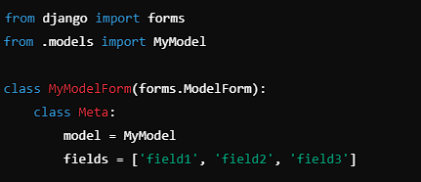
Model Forms
Model Forms automatically map form fields to model fields.
Example:
Simplifies form creation and validation for database models.

Slide 12
Benefits of Model Forms
Reduces redundancy by using existing model definitions.
Automatically provides field validation based on model field types.
Supports CRUD operations seamlessly.

Slide 13
Task 3: Create a Model Form (30 Mins)
Create a form for a model Book with fields like title, price, and description etc.
Implement form validation for price (e.g., must be positive).

Slide 14

Q&A Session

